Slide 1

Network-layer Mobility for Linux lispmob.org

Slide 2
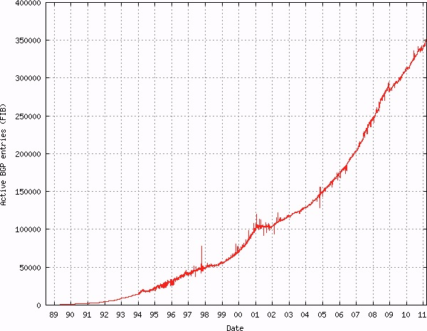
“… routing scalability is the most important problem facing the Internet today and must be solved … ”
Internet Architecture Board (IAB)
October 2006 Workshop (RFC 4984)
  Why do current IP semantics cause scaling issues?
    Today, “addressing follows topology,” which limits route aggregation compactness
    Overloaded IP address semantic makes efficient routing impossible
    IPv6 does not fix this
Notes:
Reduction of routing table size in the “default free zone” (DFZ)
35,000 active BGP entries
Why are route scaling issues bad?
Routers require tons of expensive memory to hold the Internet Routing Table in the forwarding plane
It’s expensive for network builders/operators
Replacing equipment for the wrong reason (to hold the routing table); replacement should be to implement new features

Slide 3
LISP: Introduction
The current IP routing and addressing architecture uses a single numbering space, the IP address, to simultaneously express two functions about a device:
  its identity
  how / where its is attached to the network
The Locator ID Separation Protocol (LISP) creates a new paradigm by splitting
  the device identity, or the endpoint identifier (EID) and
  its location, or its routing locator (RLOC) into two different numbering spaces.
LISP
  requires no hardware / software changes to hosts
  is incrementally deployable in the network infrastructure
  is a simple, open standard protocol (IETF)
Notes:
- Reduction of routing table size in the “default free zone” (DFZ)
Incremental introduction of IPv6
Cost-effective multi-homing with potentially no BGP dependency
Ease of renumbering burden when clients change providers
Traffic engineering capabilities, simplify multi-homed routing
Facilitate any-to-any WAN connectivity
Mobility without address changing
virtual machine mobility
reduce operational complexity

Slide 4



LISP: Overview
LISP creates a Level of indirection with two namespaces: EID and RLOC
EID (Endpoint Identifier) is the IP address of a host – just as it is today
EID RLOC
a.a.a.0/24 w.x.y.1
b.b.b.0/24 x.y.w.2
c.c.c.0/24 z.q.r.5
d.d.0.0/16 z.q.r.5
MS/MR
EID RLOC
a.a.a.0/24 w.x.y.1
b.b.b.0/24 x.y.w.2
c.c.c.0/24 z.q.r.5
d.d.0.0/16 z.q.r.5
EID Space
RLOC (Routing Locator) is the IP address of the LISP router for the host
EID RLOC
a.a.a.0/24 w.x.y.1
b.b.b.0/24 x.y.w.2
c.c.c.0/24 z.q.r.5
d.d.0.0/16 z.q.r.5
Non-LISP
xTR
EID-to-RLOC mapping
EID-to-RLOC mapping is the distributed architecture that maps EIDs to RLOCs
Prefix Next-hop
w.x.y.1 e.f.g.h
x.y.w.2 e.f.g.h
z.q.r.5 e.f.g.h
z.q.r.5 e.f.g.h
PxTR
RLOC Space
xTR
xTR
EID Space
Network-based solution
No host changes
Minimal configuration
Incrementally deployable
Support for mobility
Address Family agnostic

Slide 5


LISP-MN Control Plane
Map-Registration
PI EID-prefix
2.0.0.0/24
Mapping System
65.1.1.1
66.2.2.2
MR
MS
TR
Provider A
10.0.0.0/8
Provider X
12.0.0.0/8
S1
10.0.0.1
12.0.0.2
S
11.0.0.1
Provider Y
13.0.0.0/8
13.0.0.2
LISP-MN EID
3.0.0.3/32
S2
Provider B
11.0.0.0/8
LISP Site
TR
LISP Site
12.0.0.2-> 66.2.2.2
LISP Map-Register
(udp 4342)
SHA-1
3.0.0.3/32
12.0.0.2, 13.0.0.2
Legend:
EIDs -> Green
Locators -> Red
Physical link

Slide 6


LISP-MN Control Plane
Map-Request
PI EID-prefix
2.0.0.0/24
Mapping System
65.1.1.1
66.2.2.2
MR
MS
TR
Provider A
10.0.0.0/8
Provider X
12.0.0.0/8
S1
10.0.0.1
12.0.0.2
S
11.0.0.1
Provider Y
13.0.0.0/8
13.0.0.2
LISP-MN EID
3.0.0.3/32
S2
Provider B
11.0.0.0/8
LISP Site
TR
LISP Site
2.0.0.2 -> 3.0.0.3
How do I get to 3.0.0.3?
DNS entry:
D.abc.com A 3.0.0.3
11.0.0.1 -> 65.1.1.1
[2]
[3]
[4]
LISP ECM
(udp 4342)
11.0.0.1 -> 3.0.0.3
Map-Request
(udp 4342)
nonce
Legend:
EIDs -> Green
Locators -> Red
Physical link
11.0.0.1 -> 3.0.0.3
[1]
Map-Request
(udp 4342)
nonce

Slide 7
LISP-MN Control Plane
Map-Reply
PI EID-prefix
2.0.0.0/24
Mapping System
65.1.1.1
66.2.2.2
MR
MS
TR
Provider A
10.0.0.0/8
Provider X
12.0.0.0/8
S1
10.0.0.1
12.0.0.2
S
11.0.0.1
Provider Y
13.0.0.0/8
13.0.0.2
LISP-MN EID
3.0.0.3/32
S2
Provider B
11.0.0.0/8
LISP Site
TR
LISP Site
12.0.0.2 ->11.0.0.1
EID-prefix: 3.0.0.3/32
Locator-set:
12.0.0.2, priority: 1, weight: 50 (D1)
13.0.0.2, priority: 1, weight: 50 (D2)
Map-Reply
(udp 4342)
nonce
3.0.0.3/32
12.0.0.2 [1, 50]
13.0.0.2 [1, 50]
[6]
Mapping
Entry
Legend:
EIDs -> Green
Locators -> Red
Physical link

Slide 8


LISP-MN Data Plane
Unicast Packet Forwarding
PI EID-prefix
2.0.0.0/24
Mapping System
65.1.1.1
66.2.2.2
MR
MS
TR
Provider A
10.0.0.0/8
Provider X
12.0.0.0/8
S1
10.0.0.1
12.0.0.2
7
S
11.0.0.1
Provider Y
13.0.0.0/8
13.0.0.2
LISP-MN EID
3.0.0.3/32
S2
Provider B
11.0.0.0/8
2
TR
LISP Site
LISP Site
2.0.0.2 -> 3.0.0.3
3
4
1
11.0.0.1 -> 12.0.0.2
11.0.0.1 -> 12.0.0.2
DNS entry:
D.abc.com A 3.0.0.3
2.0.0.2 -> 3.0.0.3
2.0.0.2 -> 3.0.0.3
EID-prefix: 3.0.0.3/32
Locator-set:
12.0.0.2, priority: 1, weight: 50 (D1)
13.0.0.2, priority: 1, weight: 50 (D2)
Legend:
EIDs -> Green
Locators -> Red
Physical link
Mapping
Entry
This policy controlled
by destination site
Notes:
TODO: need to reduce the number of details on this slide

Slide 9
LISP-MN Data Plane
Inter-networking with non-LISP sites
Non-LISP
site
7.0.0.0/24
Mapping System
BGP Announcement: 3.0.0.0/24
MS
Map-Request
Map-Reply
Provider X
12.0.0.0/8
12.0.0.2
S
11.0.0.1
PxTR
Provider Y
13.0.0.0/8
13.0.0.2
LISP-MN EID
3.0.0.3/32
Provider B
11.0.0.0/8
BR
EID-prefix: 3.0.0.3/32
Locator-set:
12.0.0.2, priority: 1, weight: 50 (D1)
13.0.0.2, priority: 1, weight: 50 (D2)
Mapping
Entry
Notes:
TODO: need to reduce the number of details on this slide

Slide 10
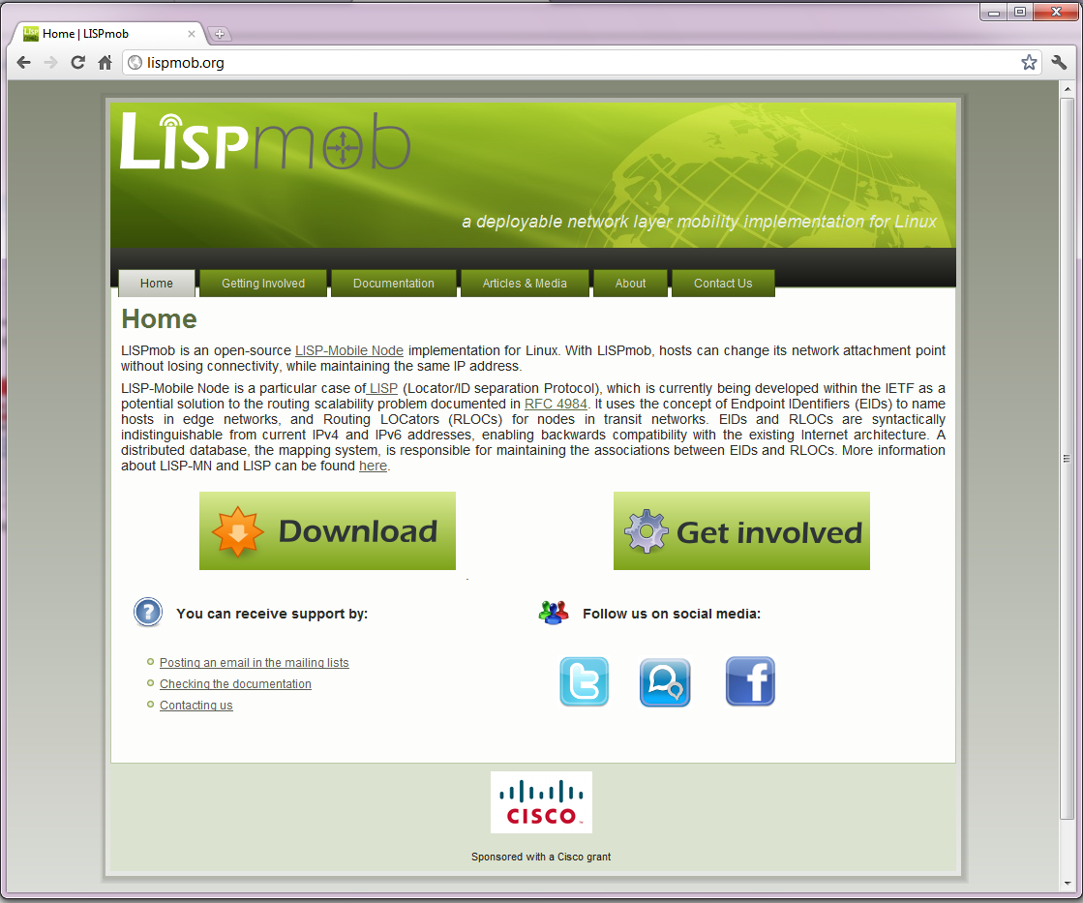
LISPmob (lispmob.org)

Slide 11
LISPmob: Some details
LISPmob is an open-source implementation of LISP-MN
  Linux (kernels 2.6.4 and 3.0.0)
  Compliant with latest draft
  Inter-operability tests with reference LISP implementations (NX-OS, IOS)
LISPmob features
  Mobility
  Multihoming: Multiple interfaces per node
  Full IPv6 support: IPv4-over-IPv6 or IPv6-over-IPv4

Slide 12



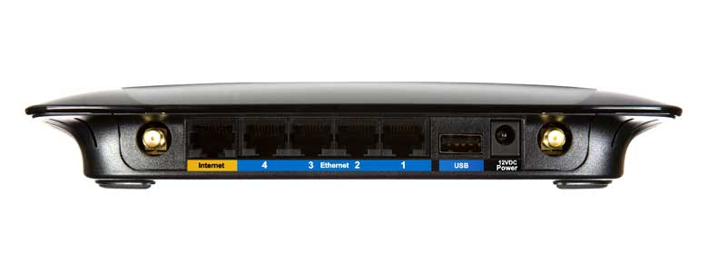
LISPmob: Hardware support
Desktop/Servers
Smartphones
(Android)
Embeded devices
(OpenWRT)

